Slide 1
Lead Scoring Case study
Aishwarya Kadaveru

Slide 2
Executive Summary and Recommendations
Agenda:
Problem Statement
Analysis Approach
Exploratory Data Analysis
Conclusion
Recommendations

Slide 3
Problem Statement:
X Education sells online courses to industry professionals.
X Education is able to generate leads through various sources like online platform, past referrals etc.
However, the typical lead conversion rate at X education is around 30% which is very poor.
X Education needs help to select the most promising leads, i.e. the leads that are most likely to convert into paying customers.

Slide 4
Analysis Approach:
1. Data Importing
2. Dropped the columns
•With no useful information
• High number of missing values
3. Missing value imputation
4. In the EDA step we did :
• Univariate Analysis
• Bivariate Analysis
•Multi Variate analysis
5. Dummy Variables Creation (Object Data Type Variables)
6. Train test Split (70/30) & Scaling continuous numeric features(Using Min Max Scaler)
7. Model Building:
• Using Logistic Regression
•Combined RFE & manual Selection
• Chose features which were most significant & had low VIF
8. ROC Curve & Precision Recall tradeoff for Cutoff Value estimate
9. Predicting the results and metrics on the Train - Test data.
10. Adding the Score Column in main data frame

Slide 5
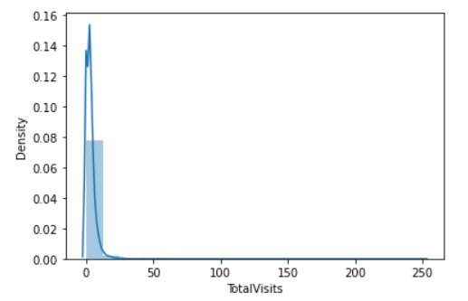
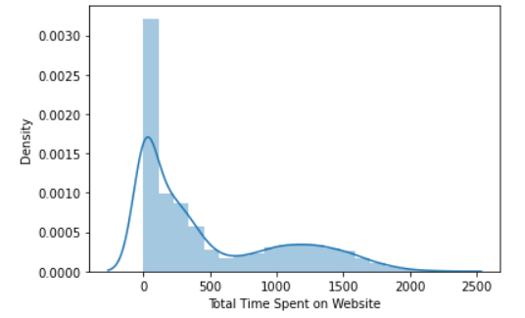
Exploratory Data Analysis
Univariate Analysis:
Highlights:
Most of the people paid not more than 25 visits
The time spent on the website was also showing dropping trend
Univariate analysis was not able to add much of insight to the study
However we did not remove any outliers as they were adding important information to the model.

Slide 6
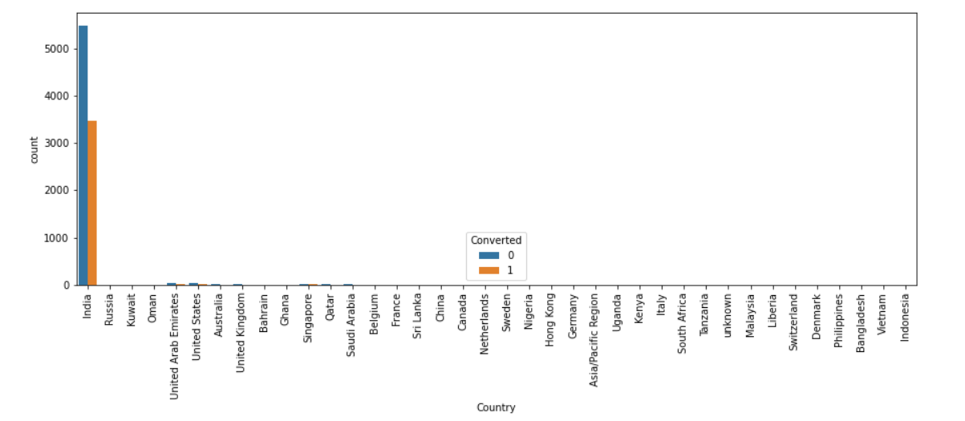
Bi variate analysis
Highlights:
Maximum number of leads did not disclose their Specialisation
The Management specialisation is which the maximum leads have shown interest towards the courses.

Slide 7
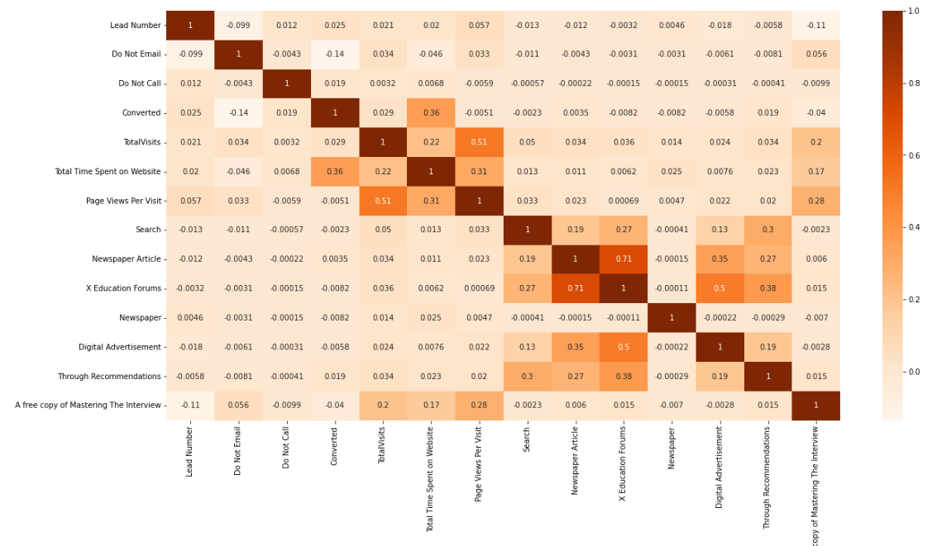
Multivariate Analysis:
Highlights:
There is a significant positive relationship of Total time spent on website and the conversion rate
Hence it is clear & logical indicator that the interested candidate will share more amount of time on the website.

Slide 8
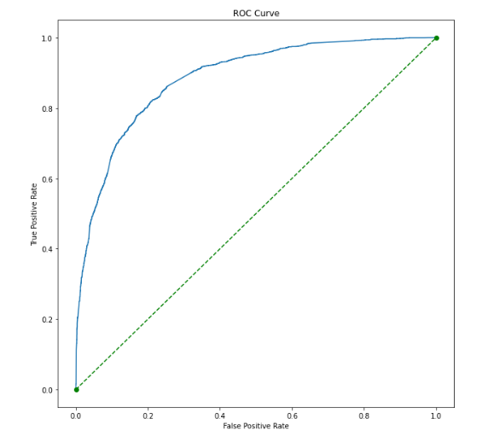
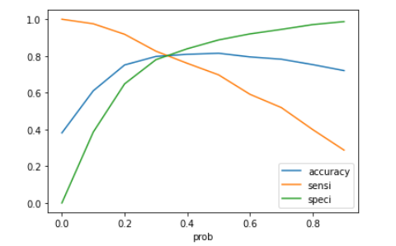
conclusion
Highlights:
Area under the ROC Curve came to be ~ 0. 89 which is a fair score.
Accuracy , sensitivity and specificity seem to cross each other 30% approx.
However we chose 25% as the cut off as we wanted to have high recall/sensitivity.

Slide 9
Conclusion
VIF is maintained below 2 which helps to reduce the multicollinearity for the model.
All the features that are preserved in model are significant i.e. they have p-value below 0.05
The evaluation metrics are proving that the model is stable and predicting results decently.
Accuracy –0.79
Recall –0.86
Precision –0.68
F1 Score –0.76

Slide 10
Recommendation
After looking at the Final Model we understand that the Company can focus on following variables to convert a Lead into customers:
Should focus on:
Number of visits to the Platform
Duration spent on Platform
Regular phone conversation with the Lead
Should not focus on:
People who do not give Email Id’s
People who do not intend to give their occupational Details.

Slide 11
Thank You

